Slide 1
LGBM REGRESSION

Slide 2
LGBM regressor is an Gradient boosting algorithm. It optimized for speed and efficiency .
It outperforms the other boosting algorithm.
It uses the gradient boosting decision tree.
It built trees leaf wise instead level wise.
It will train the weak leaners and combine them to make as a strong learner to built the predictive model.
Leaf wise growth

Slide 3
LGBM Regression work process:
Training Data
Step-1 Model Starts with Initial Prediction
Step-2 Compute the Gradient and Hessian for Boosting
Step-3 Construct decision tree(update the leaf value)
Finally I will create a model once the weak learners are trained.
Step-4 Update the model with new tree and repeat the steps

Slide 4
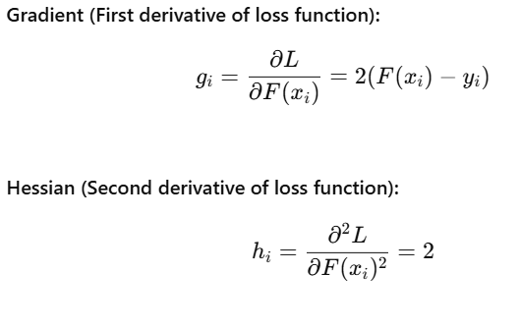
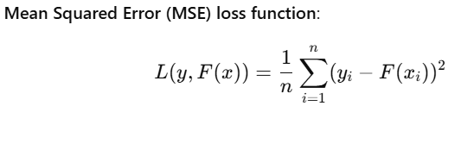
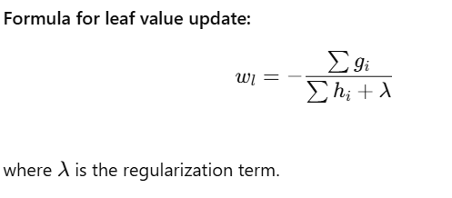
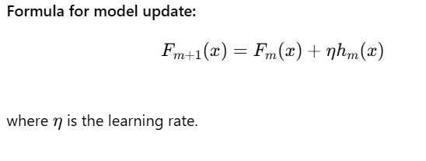
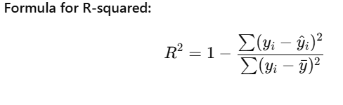
Formulas:

Slide 5
Pros:
Faster than traditional boosting algorithms.
Handles large datasets efficiently.
Supports categorical variables natively.
Provides high accuracy with fine-tuned parameters.
Cons:
Sensitive to hyperparameter tuning.
May overfit if num_leaves is set too high.
Not ideal for small datasets due to leaf-wise growth.
Requires GPU for the best performance in large-scale problems.

